Slide 1
Hot-Soft Jobs.com
online site for software jobs
By
ABHIJITH D.A. – 1PI01IS001
MAHESH M.P. – 1PI01IS042

Slide 2
Introduction
It’s an online site for searching and publishing jobs.
It is an online site specifically for SOFTWARE/IT oriented jobs.

Slide 3
Why “Hot-Soft Jobs .com” ?!!
Till now there was no site for specifically for SOFTWARE/IT oriented jobs.
Searching process for Software/IT oriented jobs become faster and easier for both Job Seekers and Job Publishers.

Slide 4
Problem Definition
Hot-Soft Jobs.com provides an easy access to search IT / Software jobs .
Members can have overview of jobs available in software related area.
Employers can publish their personnel requirements.

Slide 5
Two Users
The two types of users are
Members (Job seekers.)
Employers (Job providers.)
Database of “Hot-Soft Jobs.com” is managed by “Administrators”.

Slide 6
For Member’s
Creating/Updating Resume.
Changing/Updating ones profile.
View Sample Question Papers.
Search for jobs.

Slide 7
For Employer’s
Posting Jobs.
Viewing Resumes.

Slide 8
Requirements of Administrators
Knowledge about MY-SQL database.
Job “type” and “payment”.

Slide 9
Data Flow Diagram of Employers
POST
JOB
Enter
SELECT
OPTIONS
Job
Description
Database
VIEW
RESUME
Sample Question
Papers

Slide 10
Data Flow Diagram of Members
LOGIN
Member
SELECT
OPTIONS
Sign out
LOGOUT
Enter
Access Student
Details
New user
Access System
Details
Password
Database
VIEW
COMPANY
PROFILES
REGISTER
Access Time Table
Details
SAMPLE
PAPERS
Company
Database
INTERVIEW
TIPS
Member
Database
Sample Question
Papers
Interview’s
Help

Slide 11
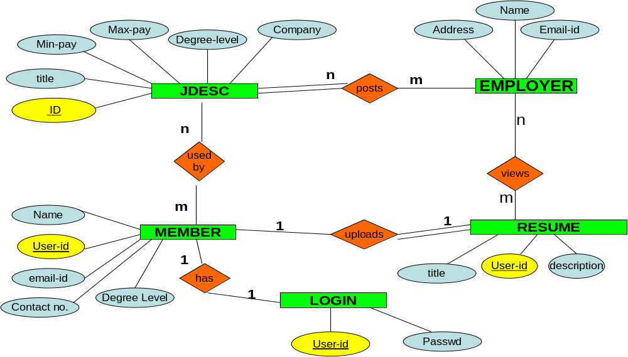
ER-DIAGRAM.

Slide 12
Pseudo code
1> Home page
Start HomePage.
If clicked=Login
Then
Go to login page
Else
if selected=Create_New_Account
then
go to Register form.
End
End
Finish

Slide 13
Pseudo code (…contd)
2> Login page
Start LoginPage
If User=Member
then
if Password is correct
then
Go to MyHome Page
Else
Display invalid password
End
Else
Display invalid user
End
Finish

Slide 14
Pseudo code
3> Login page
Start PostJobPage
Fill in details
Submit
Finish

Slide 15
REQUIREMENT SPECIFICATIONS
Hardware Requirements.
CPU – 486MHz.
Memory – 32MB.
Monitor, Keyboard, Mouse.
Internet/Networked Computers.
Software Requirements.
Perl and MySql Interpreter.
Apache Server.
Any Editor.
Microsoft FrontPage.
Any Web Browser.

Slide 16
Testing and Validation
If wrong user-ID or Password is entered, a message is displayed.
If any mandatory field is missed, while entering the form, it is alerted.
Directly opening certain forms causes an invalid state.

Slide 17
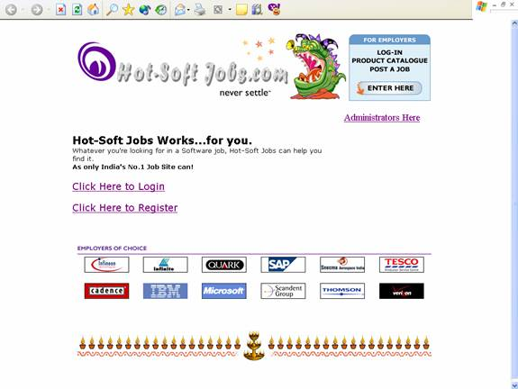
Sample Snap Shots

Slide 18
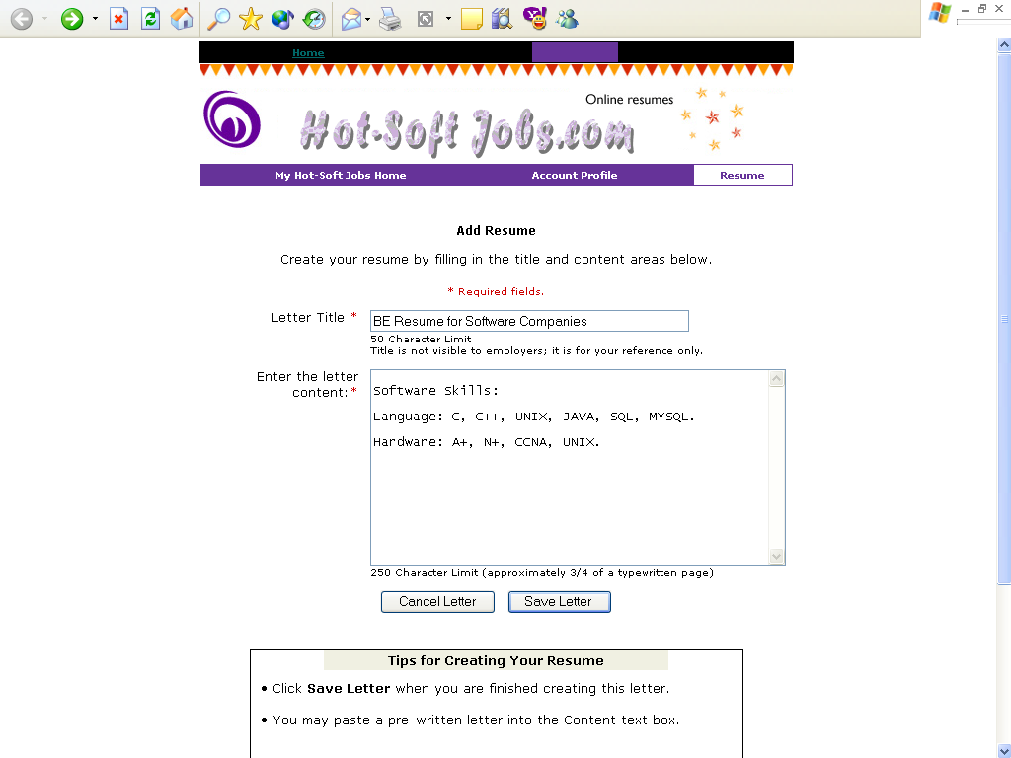
Sample Snap Shots

Slide 19
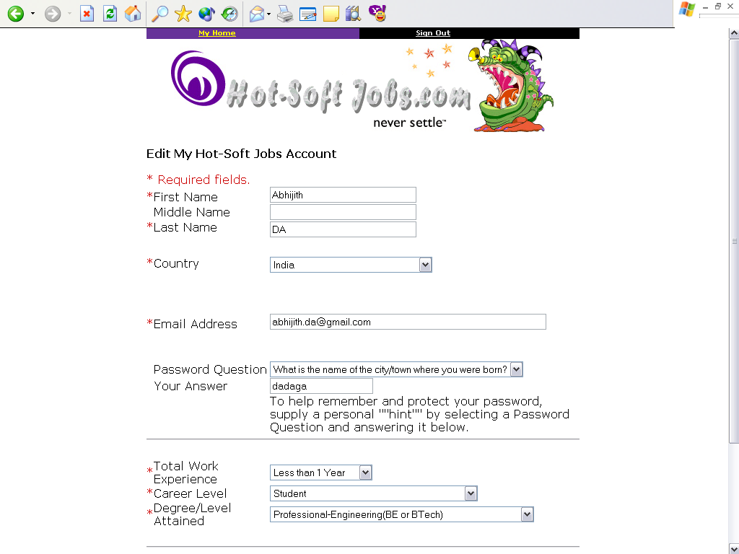
Sample Snap Shots

Slide 20
Conclusion
The project uses Apache Server, My-SQL, PERL Interpreter.
The user interface is made as attractive as possible so that it keeps the interest of the user.
It employs cookies and Java Script to achieve its objective.

Slide 21
Future Enhancements
The project has been developed keeping in mind any future enhancements to the project, as it is open source code product.
This project can be extended to much more sophisticated internet application software, where a person or a group of persons, can make changes to database like deleting the old jobs, which were posted. The team can also check for the correctness of the Job Posts.

Slide 22
Applications
With few enhancements, we can make it a commercial website.
Can be used to explain students to show how internet or CGI programs work.

Slide 23
Bibliography
CGI Programming on the World Wide Web - Shishir Gundavaram.
PERL MAN pages in Linux OS.
HTML Complete Reference - BPB Publications.
Concepts from Naukri, Hot Jobs and Monster sites.

Slide 24
T H A N K Y O U

